Slide 1
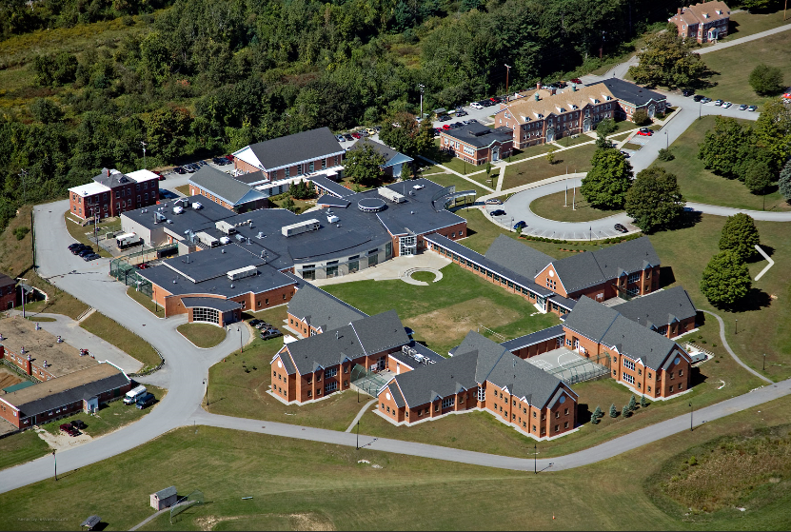
Sununu youth services center: Planning for transition March 10, 2021 Before House Finance Division III

Slide 2
Years of change
1992 - Juvenile Detention Alternatives Initiative JDAI
2000 - From Neurons to Neighborhoods: The Science of Early Childhood Development, Shonkoff & Phillips
2011 - No Place for Kids: The Case for Reducing Juvenile Incarceration, Annie E. Casey Foundation
2013 – The effect of youth diversion programs on recidivism, Wilson & Hoge
2017 - NH HB 517 shifted use of SYSC
2018 - Family First Prevention Services Act
2018 - Transforming Juvenile Probation: A Vision for Getting it Right, Annie E. Casey Foundation
2019 – NH SB 14 Expanding the System of Care
2021 – NH SB 94 establishing pre-petition assessment

Slide 3
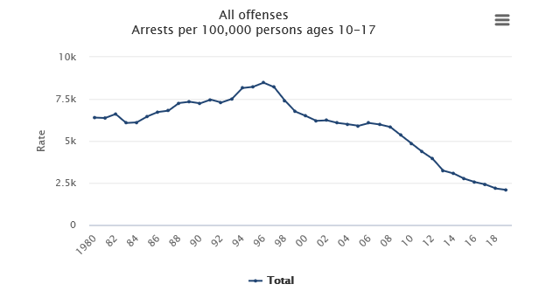
Office of Juvenile Justice & Delinquency Prevention

Slide 4
FIRST, Need: Planning for an alternative
Current Delinquency Population in Institutions
(of 1750+/- adjudicated children)
SYSC:
13 children (2 from Maine)
2020: Average daily census hovering around 17
Residential Placements
52 (39 in state, 13 out of state)

Slide 5
Current sysc population
Of the 11 NH children at SYSC Today
2 detained, 9 committed
At least 2 are there awaiting placement options: foster care or residential program
8 have a combined history of more than 82 abuse/neglect referrals ranging from 7-31 each
3 had child in need of services cases (CHINS)
4 have been in multiple residential programs
6 are there on parole violations

Slide 6
Decisions should reflect investments in healthy development & Resilience
Nurturing supportive relationships (caring, consistent adult)
Living, playing, learning in safe, stable environment
Community engagement and sense of belonging
Learning to express emotions in healthy way
Sege & Browne, 2017)

Slide 7
Core Components of the continuum: New Hampshire At the ready
Expanding system of care
Rapid mobile crisis response that will go to homes AND schools where most offenses stem from
Expanded Fast Forward Wrap Around Care Coordination Service
Multi systemic therapy – evidence-based intensive 24/7 in-home wrap around care for child and whole family
Care Management Entities (CME) & Comprehensive Assessment Treatment (CAT)
Procured residential services
Probation transformation – pre-petition assessments and services / Expand diversion

Slide 8
Transition care & Re-invest
Transition the Population at SYSC to:
Missouri Model-Style 12-14 bed secure home
Multi-Dimensional Treatment Foster Care – 10 beds

Slide 9
Missouri Model-Style 12-14 bed secure home
Size accommodates for possible census fluctuation
Home-like environment maintains promotes normalcy and connections with community
Treatment milieu emphasizes rehabilitation and healthy child development

Slide 10
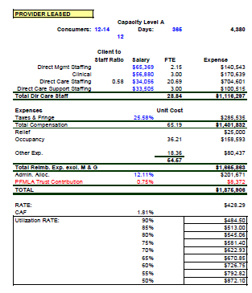
Vermont 6-Beds
Direct Mgmt – 6
Clinical – 3
Direct Care - 28
Direct Care Support – 4
Teacher - 1
Operations
Operations - $3,885,662
Per bed - $1,744
Construction - $5,298,233
Missouri-style Model Secure Home
Massachusetts
12-14 Beds

Slide 11
Education & Health Care
Massachusetts has contracts for health care services and an independent school both of which are embedded in the group homes.
The independent school affords the ability to ensure quality, licensed teachers and control of the curriculum.
Difficult to calculate projected cost for this model in New Hampshire given significant difference in population size

Slide 12
Multidimensional Treatment Foster Care
Alternative to incarceration and residential placement
Intensive therapeutic foster home designed specifically for adolescents with chronic antisocial behavior, emotional disturbance and delinquency
Exceptional training and support for foster parents
Treatment & training for both youth and parents
5-15 months stay
$25,000 – 35,000 per young person

Slide 13
Re-investment fundS
Two Funds Necessary
System enhancements for youth success
Intensive mentoring and support programs
Flex funds for individualized tailored services
Family Resource Center contracts for assessment and diversion services
SYSC staff re-training, re-deployment

Slide 14
Planning is prevention and savings
Multi-agency work group:
Include community and experienced families
Review all cases of youth at SYSC for alternative placement and all-system service plans
Achieve consensus on model for locked facility including school and health care services
Maintain momentum for change
Monitor implementation and quality outcomes

Slide 15
concerns to contemplate
Accommodating gender
Overnight arrests
Detention/commitment shared space
Geographical location
NIMBY

Slide 16
Seek Other funding opportunities
FFPSA prevention services
Office of Juvenile Justice Delinquency Prevention Title II formula funds to the State Advisory Group – revisit and reinvest. Consider use for: Job training, mental health and substance use treatment, community-based programs, re-entry/after care services, truancy prevention
Office of Juvenile Justice Delinquency Prevention discretionary grants: Youth mentoring, substance use treatment, JJ system support, youth gangs violence prevention, re-entry services

